Slide 1
VIRINA STEEL US Patent 13/873,838 Filed in 2013 for Grinding Ball Formula

Slide 2
BENEFITS OF VIRINA GRINDING BALLS FOR YOUR PLANT
The only through hardness ball in the world validated by SGS
From surface to core @ 63HRC
Ultra fine grain size rated by SGS ASTM 10, top 1% in the world
The ball will stay spherical shape for its entire life
No deformation
No spitzers
No sorting except after 10 years of grinding transfer 70mm worn down to 50mm into the 2nd chamber
90mm will grind for 45 years
Reduce the mining extraction of iron and chrome ore
Reduce CO2 emission from 220 tons to 6 tons annually
If US 101 plants switch to Virina balls, 22,000 tons of CO2 can be eliminated
Increase production up to 10%
Decrease energy consumption
Decrease labor hours
Decrease management time
Extended Liner Life by 400%
Virina content 10% chrome vs 20% chrome in Traditional balls
Reduce toxic Chrome usage by 50% per ball or with much less ball consumption. Total Chrome reduction will be 95% annually
Energy savings of $500,000 per plant annually
Each ton of steel ball generates 1.83 tons of CO2 emissions
Eliminate 120 tons of traditional ball scrape and 220 tons of CO2 emissions per mill annually

Slide 3
VIRINA & TRADITIONAL BALLS LOADED IN JANUARY 2018 TEMPERATURE MEASUREMENT IN JANUARY 2024
The plant has two identical, 4500 hp – 2 compartments, 100 TPH ball mill circuits grinding Type II Portland cement.
Both mills have identical 88ton ball charges and ball size distribution.
Both mills received a fresh ball charge, one with Virina balls and Traditional balls
Virina Mill Shell temperature at 184 F
More grinding with the round surface at the Shearing and Tumbling Layer
Higher efficiency with lower energy consumption
Traditional mill shell temperature at 195 F, 11 Degrees higher
With the first compartment shell, liners, and ball charge having an
approximate weight of 153 tons and an average clinker feed rate of 95 TPH, this temperature difference is calculated to be over 400 MBTU’s. Saving $125,000 in utility fees.
Deforming ball at a time will strike the liner above the toe and damage the shelve.
A deformed ball has a higher percentage of rolling off the shelf without crushing the material.
Deformed balls at a time will slide on the liner and hit the shelve lifters. The presence of damage shelve lifters in the ball mill can have a significant impact on the lifespan of the liner. This is a critical factor to consider, as it directly affects the operational efficiency and maintenance costs of the mill.

Slide 4
VIRINA MILL @ 11 DEEGRE COOLER RESULTING $125,000 ANNUAL UTILITY SAVING

Slide 5
VIRINA BALLS WILL NOT DEFORM PROJECTED TO EXTEND THE LINER LIFE BY 4X
SPHERICAL BALLS FOLLOW A PREDICTABLE PARABOLIC TRAJECTORY INTO THE CATARACTS AND IMPACT ZONE FOR MAXIMUM CRUSHING AND GRINDING EFFICIENCY ROUND BALLS WILL ROLL OVER EACH OTHER, GRINDING THE MATERIALS IN THE SHEARING AND TUMBLING ZONE
ROUND BALLS WILL SAVE $125,000 IN ENERGY
DEFORMED BALLS WILL HAVE AN UNPREDICTABLE TRAJECTORY AND WILL DAMAGE THE SHELF OF THE LIFTER
A DEFORMED BALL WILL SLIDE ON THE LINER SURFACE AND CAUSE WEAR AND BALL RUNS.
THE USEFUL LIFE OF THE SHELL LINER IS DETERMINED BY MAINTAINING THE LINER SURFACE PROFILE AND LIFTER SHELF. MOST SHELL LINERS ARE REPLACED DUE TO THIS PROFILE WEAR AND NOT THE THICKNESS. MOST MILLS USE ONLY A FRACTION OF THE LINER WEIGHT BEFORE REPLACEMENT
ROUND BALLS WILL EXTENT THE LINER LIFE BY 400%

Slide 6
HIGH COST REPLACING DEFORMED BALLS ANNUALLY
After 2 years of grinding, a significant % of the Traditional balls are deformed. Due to the high cost, most plants will continue to grind with these deformed balls.
The average plant wear rate at 8% discards 40 tons of traditional balls annually, costing $80,000. Each ton of balls generates 1.83 tons of CO2, resulting in 86 tons of CO2 emissions per year from Traditional balls.
Below is an image of a Traditional 4-month lopsided ball with soft-core, under 60 HRC

Slide 7
Head-to-head comparison of a Virina ball charge at Large International St Louis Missouri Cement Plant
After 5 years, no noticeable deformation
Surface and core remain at 63 HRC
No sorting is necessary
Annual wear is 1.80 %
90mm down to 82mm
80mm down to 72mm
70mm down to 62mm
The plant has two identical, 4500 hp with 2 compartments and 100 TPH ball mill circuits grinding.
Both mills have recent shell and division head wear liner replacements and in similar operating condition.
Both mills have identical 88-ton ball charges and ball size distribution in the 1st chamber.
Both mills received a fresh ball charge, one with Virina balls and the other with Traditional balls
A

Slide 8
Mike Fec Industrial Services Technical Manager Sr. Metallurgical Engineer SGS MSi 1390 N 25th Avenue Melrose Park, IL 60160
Hi John,
In an attempt to cut your ball, the SGS mechanical lab tried their abrasive saws with no luck and tried 2 separate cuts.
The ball was forwarded to a shop with a more robust abrasive saw.
That was the 3rd cut.
Thank you for being a valued customer.
.

Slide 9
Per SGS Virina is the only grinding ball that has thorough hardness Surface to the core at 63 HRC Virina’s entire ball has the same hardness and will grind evenly, resulting in a Spherical shape that will never deform.

Slide 10
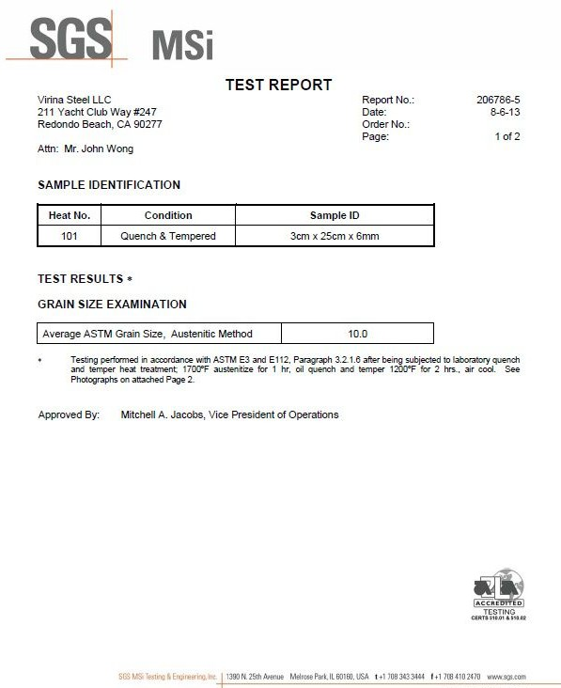
GRAIN SIZE ASTM 10
Grain sizes can range from 1 (coarse) to 8 (fine) to 10 (ultra fine)
10 is in the upper 1%.
The finer the grain size, the better the steel

Slide 11
BENTIFY REPLACING TRADITIONAL GRINDING BALLS WITH VIRINA GRINDING BALLS
Energy saving $125,000 per mill

Slide 12
VIRINA STEEL

